Slide 1

ARC Onboarding Training
Using the ARC with VS Code

Slide 2
SSH Setup
You need to confirm that you have SSH keys generated on your system
Run ssh-keygen in your local terminal to begin
  Preferably save this in your ~/.ssh folder
Create a config file in your local ssh directory
  The path should look like ~/.ssh/config
UTS

Slide 3
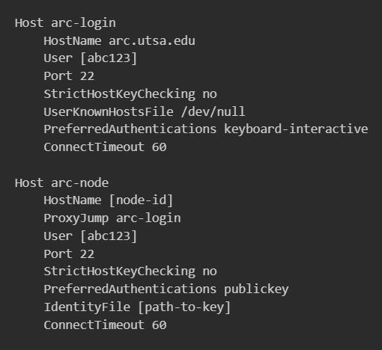
SSH Setup
Then open the file and paste the following image
Replace the arguments inside []s with your information
  For example, if your user id is xyz987 you would replace [abc123] with xyz987
UTS

Slide 4
Adding Keys to ARC
Run arc-login in the terminal
Then run nano /home/[abc123]/.ssh/authorized_keys
Copy the contents of the public key you just created, add it to this file, and save it
  Be careful not to remove the key that is already in there!
If you need to find your public key run cat ~/.ssh/myKey.pub
UTS

Slide 5
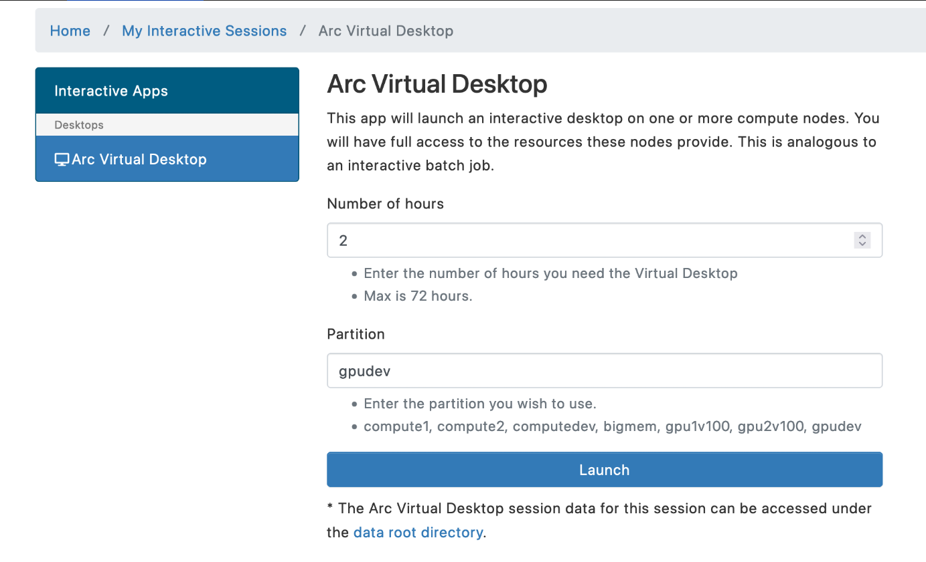
Connecting to a Node
Head over to https://portal.arc.utsa.edu to create a virtual desktop environment
Choose the node type you would like
  For this demo I would recommend sticking with a compute node
UTS

Slide 6
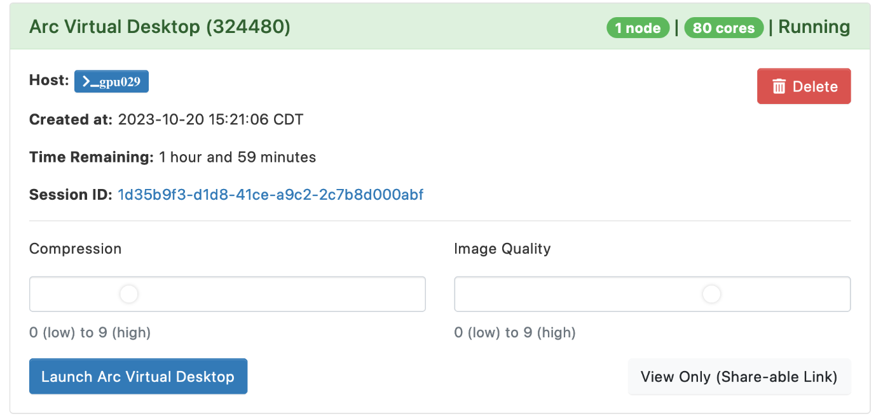
Connecting to a Node
From here you can see the ID of the node
Replace the [node-id] section of the config file we created with that id
UTS

Slide 7
VS Code Connection
Ensure that you have installed the Dev Containers, Remote – SSH, and Remote Explorer VS Code extensions
From there when you open VS Code you will see a blue bottom in the bottom corner, when you click on that, a menu will appear. Click on host then the arc-node host option.
UTS

Slide 8
VS Code Connection
Then, further prompts will appear; make sure to select the Linux environment for the VS Code server
Then you will have successfully logged into the ARC with VS Code!
Note: the command code --folder-uri “vscode-remote://ssh-remote+arc-node//work/[abc123]” will launch it from your terminal and remove repeated prompts when moving around directories
UTS

Slide 9
Feel free to reach out at Bryce.Hinkley@utsa.edu

