Slide 1

Arc Onboarding Training
Zhiwei Wang, Ph.D
Research Computing Support Group
University of Texas at San Antonio

Slide 2
Today's Coverage:
How to access Arc using:
MobaXterm (Windows)
An SSH client (Mac/Linux)
The web-based OnDemand portal (for GUI applications)
How to run jobs on Arc, including:
Access a compute node and run applications interactively
Understand job scripts and submit batch jobs
Job monitoring and long-running task management
Navigate Arc’s storage system and follow usage policies
Parallelization best practices:
Speed up applications using multiple cores
Reserve only the resources you need
Avoid idle timeouts on GPU nodes
Use batch jobs to reduce interruptions
Amdahl’s Law and Law of Diminishing Returns
Copy The Sample Code to your home directory:
$ cp -r /work/trainings/onboarding .
University Technology Solutions

Slide 3
Arc – the HPC Cluster at UTSA
167 total compute/GPU nodes and 2 login node​​
30 GPU nodes - two CPUs/40 cores, 384GB RAM, and each including one V100 Nvidia GPU​​
5 GPU nodes - two CPUs/40 cores, 384GB RAM, and each including two V100 Nvidia GPUs​​
2 GPU nodes - two CPUs/40 cores, 384 GB RAM, and 4 V100 GPUs​​
2 GPU nodes - two CPUs, one A100 40 GB GPU, and 1 TB RAM​​
2 large-memory nodes - four CPUs/80 cores, 1.5TB of RAM​​
Two Lustre filesystems: ​​
Home: 110 TBs capacity
Work: 1.1 PB of capacity

Slide 4
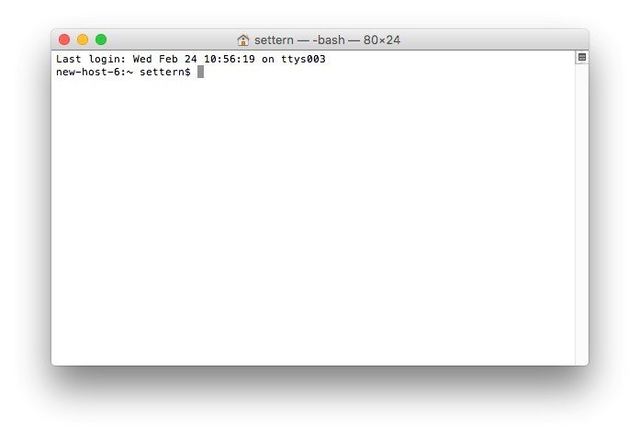
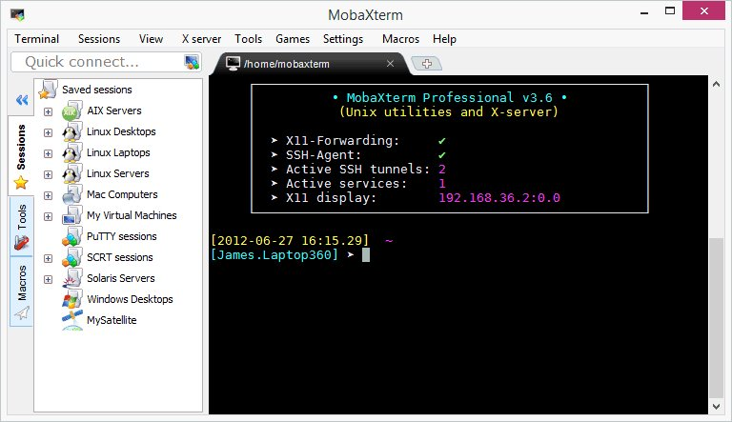
How to Access Arc
From Linux and Mac​
​
ssh abc123@arc.utsa.edu​
ssh –X abc123@arc.utsa.edu
From Windows​
​
Install a SSH client program, such as MobaXterm.

Slide 5

How to access Arc​
From Web Portal : portal.arc.utsa.edu​

Slide 6
Arc Storage
Home Directory
100GB per user
“du -sh .” to find out the size of current directory
Daily backups
Free up space regularly to ensure normal functioning of various applications
Work Directory
No disk quota (currently)
No backup system
30-day data purging policy
Vault
1TB per user for long-term data storage
Daily backups for disaster recovery
Accessible only from the login nodes

Slide 7
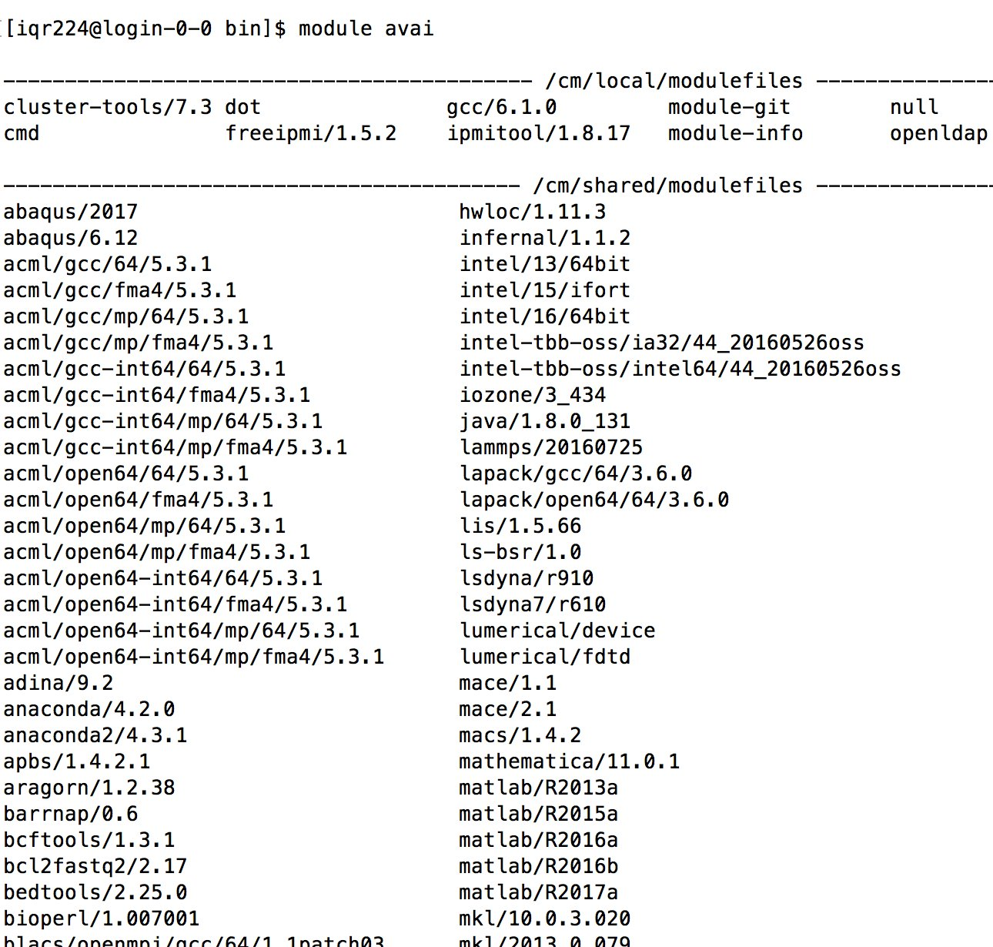
The Module System on Arc
What are the Environment Modules?​​
The Environment Modules package is a tool that lets users easily modify their environment during a session.​​
​
Typically, module loading can alter or set shell environment variables such as PATH, MANPATH, etc. Modules can be loaded and unloaded.

Slide 8
Module System on Arc
list all currently loaded modules:​​
module list​​
​
list all available modules:​​
module avai​l​
​
load a module:​​
module load name​​
​
unload a module​:​
module unload name ​​

Slide 9
Use Arc Interactively
Use the following command to obtain a compute node​​
srun -p compute1 -n 1 -t 00:05:00 -c 40 --pty bash​​
“-p compute1” or “--partition=compute1” to select the partition compute1​​
“-n 1” or “--ntasks=1” to specify one task, which is typical for interactive sessions.​​
“-t 00:05:00” or “--time=00:05:00” to specify the duration of the interactive session (up to 72 hours for compute1) ​​
“-c 40” or “--cpus-per-task=40”​ to request one CPU core (up to 80 for computer1)​​
​​
Do not run intensive programs on login nodes!!!​​
Stay on the login node if you want to compile your code or submit batch jobs.​

Slide 10
Use Arc Interactively – An Example
$ module load R
$ R
R version 4.4.1 (2024-06-14) -- "Race for Your Life"
Copyright (C) 2024 The R Foundation for Statistical Computing
Platform: x86_64-pc-linux-gnu
R is free software and comes with ABSOLUTELY NO WARRANTY.
You are welcome to redistribute it under certain conditions.
Type 'license()' or 'licence()' for distribution details.
Natural language support but running in an English locale
R is a collaborative project with many contributors.
Type 'contributors()' for more information and
'citation()' on how to cite R or R packages in publications.
Type 'demo()' for some demos, 'help()' for on-line help, or
'help.start()' for an HTML browser interface to help.
Type 'q()' to quit R.

Slide 11
Batch Job – Job Script
#!/bin/bash​​
#SBATCH --job-name=test # Change to your job name​​
##SBATCH --output=out.txt​
#SBATCH --partition=compute1​​
#SBATCH --ntasks=1​​
#SBATCH --nodes=1​​
#SBATCH –-time=4:00:00​​
#SBATCH --cpus-per-task=40​
#SBATCH --mail-type=ALL​
#SBATCH --mail-user=zhiwei.wang@utsa.edu​
​
module load anaconda3​
python hello.py
University Technology Solutions

Slide 12
Batch Job – Submit a Batch Job
Submit the job to a queue​​
​$ sbatch jobscript​​
​
Check the status of the job​​
$ squeue​ -u abc123​
​​
Delete a job from the queue​​
$ scancel jobID​
University Technology Solutions

Slide 13
Batch Job – Slurm Commands
Show the partition info:​
sinfo​
Show the node status​
sinfo -N -l​
​
Show jobs status:​
squeue​
Show jobs status of specified user:​
squeue -u abc123​
Show jobs in waiting:​
squeue --start​
Show jobs on a specified node:​
squeue --nodelist=gpu03​
Show jobs in a specified partition:​
squeue -p gpu1v100​
​
Show status of a specify job:​
squeue -j jobID​
R - job is running on compute nodes​
PD - job is waiting on compute nodes​
CG - job is completing​
Cancel a job:​
scancel 12345.​

Slide 14
Handling Long Tasks on Arc
Avoid Interactive Jobs for Long Tasks
Optimize parallelization to reduce runtimes.
Splitting large tasks.
Check resource limits and allocate appropriately
72-hour runtime limit for most of the partitions on Arc
10-day runtime limit for compute2 partition
Request the correct wall time based on previous experience.
Use checkpointing to save progress and restart from failures.
Monitor job status regularly and use notifications.
Test on smaller models to catch issues early.

Slide 15
GPU Node Idle Timeout on Arc
GPU jobs will be automatically terminated if no GPU activity is detected for two hours
Ensure that all jobs submitted to GPU nodes actively utilize GPU resources
Exit GPU interactive sessions when your GPU tasks are complete

Slide 16
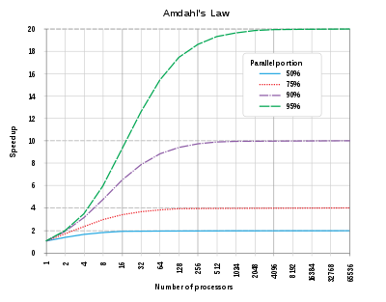
Amdahl’s Law
Not all parts of a program may be parallelizable, and increasing the number of workers beyond a certain point may not lead to improvements due to the sequential portion of the task.

Slide 17
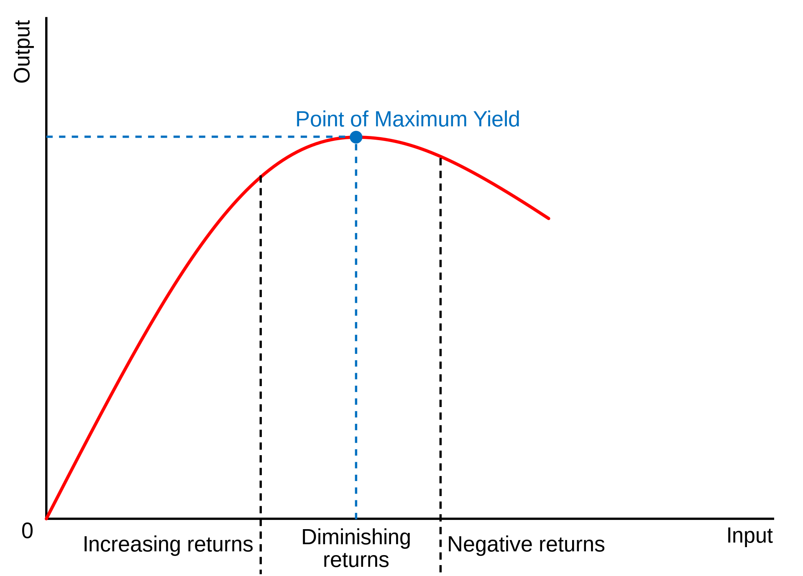
Law of Diminishing Returns
Beyond a certain number of parallel workers, you may observe reduced incremental benefits or even a degradation in performance due to overhead and resource contention.

Slide 18
Useful Linux Commands
To find files in specified directory:
find /home/username/ -name "*.err” ​​
To list the files in current directory​:
ls
To delete a file ​:
rm filename
To show the path of the current directory:
pwd
To change directory​​
cd new-directory-path
​​
Arc User-Guide Site:​
https://hpcsupport.utsa.edu/foswiki/bin/view/ARC/WebHome​
Create A Ticket for Technical Support:​
https://www.utsa.edu/techsolutions/service-now/​

